Slide 1

72 second street harrington
Client: Dinesh Bala S

Slide 2
72 second street harrington
Property image
Notes:
Add property image from OS map using nimbus or landinsight. Add type of property & the site area. Do the critical checks.

Slide 3
Property Images
3d views
3d views
Notes:
views from google earth with marking of the property boundary

Slide 4
Property Information
OS Map
Property type- 2BHK
Council : British Council.
Built Area - 900 Sqm
Conservation area, Grey belt, Restrictive covenant, National Park, Affordable housing, Ecology, Contaminated land, Sites of Scientific Interest, CIL
Notes:
Add property image from OS map using nimbus or landinsight. Add type of property & the site area. Do the critical checks.

Slide 5
Scope of Works
House
Notes:
Add in the brief provided by the client

Slide 6
Conceptual design
Conceptual design
Notes:
views from google earth with marking of the property boundary

Slide 7
Conceptual design - Plan
Notes:
views from google earth with marking of the property boundary

Slide 8


Similar Planning Applications
88, North wales, UK
Timeline : 3 months
asdasdasdasasdasdasdasasdasdasdas

Slide 9
Existing and Proposed Floor Plan
9
Notes:
Add in the brief provided by the client

Slide 10
Existing and Proposed Elevations
10
Notes:
Add in the brief provided by the client

Slide 11
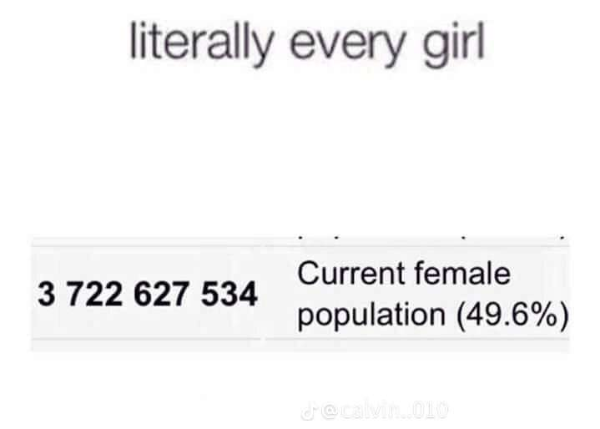

Similar Planning Applications
34, Johnson street, Wales
Timeline : 6 months
asdadasdadasdadasdadasdadasdad

Slide 12
Existing and Proposed plans
12
Notes:
Add in the brief provided by the client

Slide 13
Existing and Proposed elevations
13
Notes:
Add in the brief provided by the client

Slide 14
Reasons for rejection
14
Notes:
Add in the brief provided by the client

Slide 15
How to bypass
15
Notes:
Add in the brief provided by the client

Slide 16
Documents to be Submitted
Full application- 3 Months (from submission) Till Decision Notice
Required Documents:
Fire Strategy (a third party document), CIL (a third party document), Sustainable Drainage assessment (a third party document), Sunlight and Daylight Assessment (a third party document), Landscape Plan (a third party document), Ventilation statement (a third party document), EMAQ statement (a third party document), Noise Survey (a third party document), Radon Risk Assessment (a third party document)

Slide 17
Process of Works
Site Assessment and Feasibility: Evaluate the property to design development focusing on space optimization, accessibility, and the intended function, while ensuring full compliance with planning regulations.
Measured Survey & Architectural Drawings: Perform a measured survey and produce architectural drawings, including floor plans, elevations, sections, and site plans, ensuring accuracy for both planning and construction purposes.
Pre-Planning application : Prepare and submit a schematic planning application for the proposed development, ensuring compliance with local planning standards and requirements.
Full planning Planning Application: Prepare and submit a detailed planning application for the proposed development, ensuring compliance with local planning standards and requirements.
Notes:
Add in the brief provided by the client

Slide 18
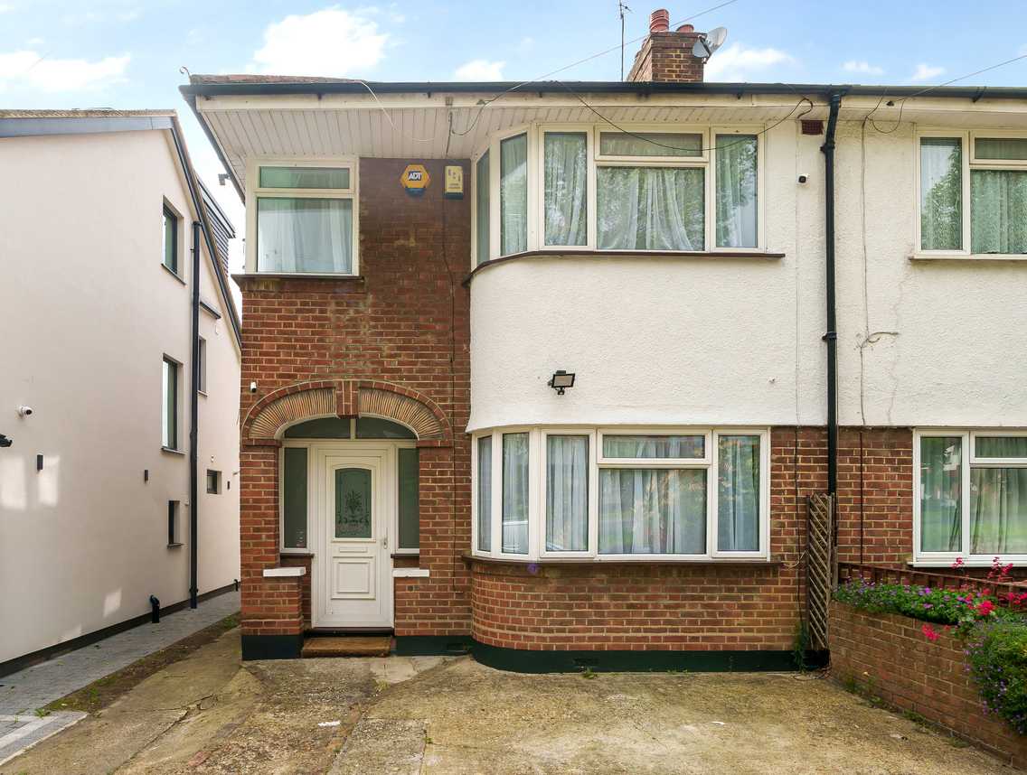
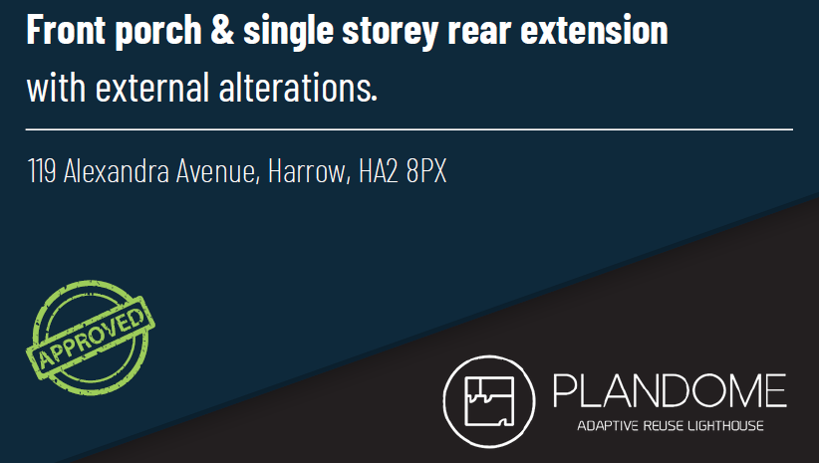
Track Records

Slide 19
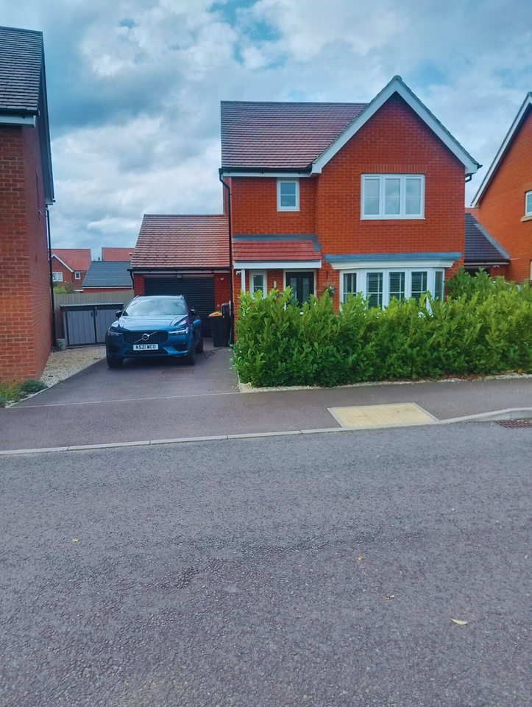
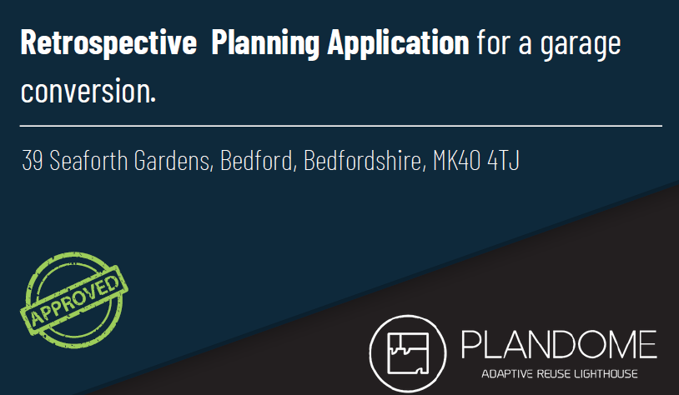
Track Records

Slide 20
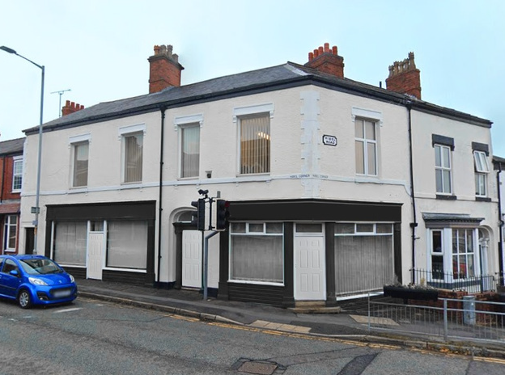
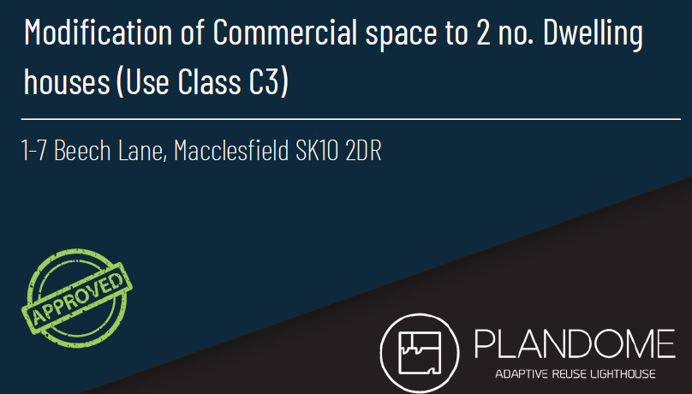
Track Records

Slide 21
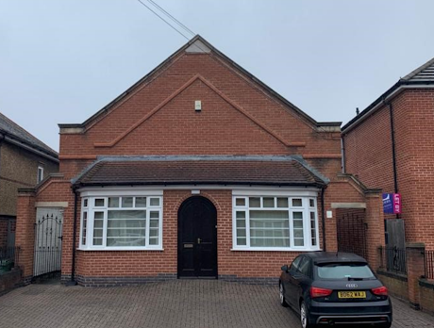
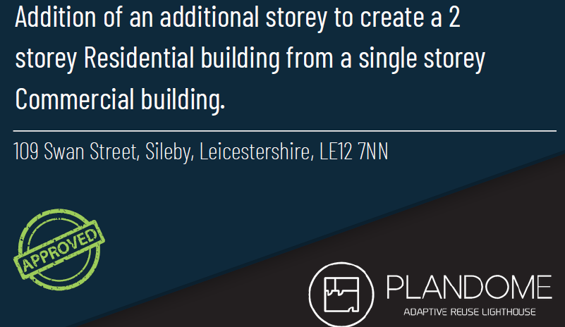
Track Records

Slide 22
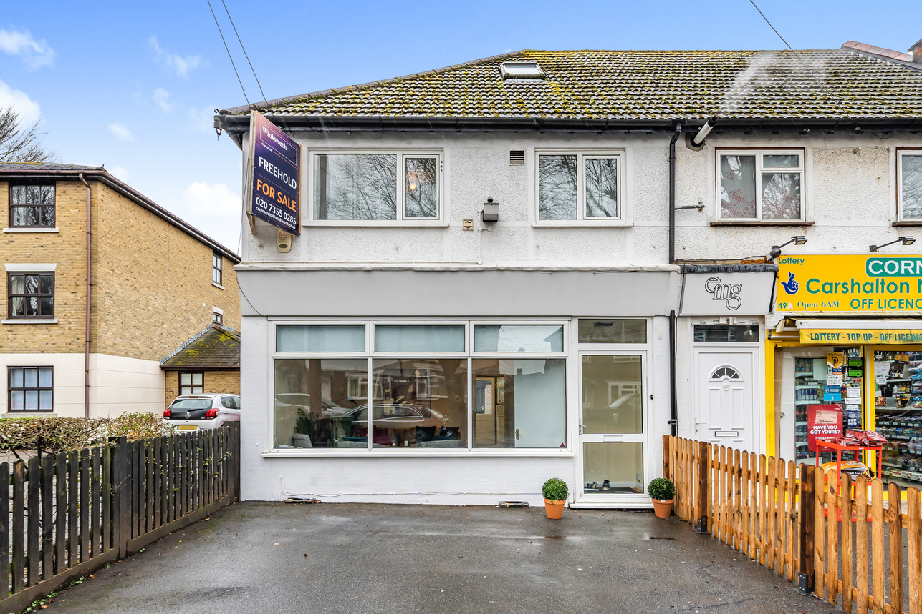
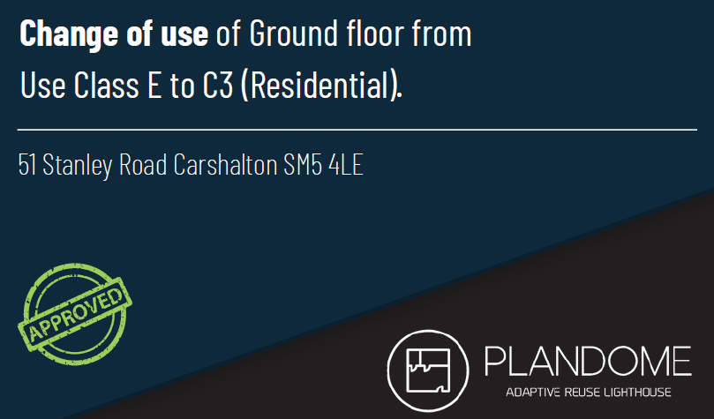
Track Records

